Slide 1
DELE CA1
Tan Yu Hoe | P2026309
Diploma in Applied AI and Analytics | DAAA/FT/2B/04
School of Computing | Singapore Polytechnic
tanyh.20@ichat.sp.edu.sg
DELE | ST1504
CA1 Assignment
Notes:
Hello everyone, today I will presenting on my work/approach for Deep Learning CA1.

Slide 2
Table of Contents
Methodology and Motivation
Exploratory Data Analysis
Feature Engineering & Image Augmentation
CNN Architectures and Variations
Results & Discussion
Notes:
In this presentation, I will be sharing mostly on my attempt for this Assignment. I will be going through on the (1) Methodology and Motivation (2) Exploratory Data Analysis (3) Feature Engineering & Image Augmentation (4) CNN Architectures and Variations (5) Results and Discussion.

Slide 3
Methodology and Motivation
In the assignment, both Part A (Fashion MNIST) and Part B (CIFAR-10) provided are a dataset of images and labels, and the task is to create a Convolutional Neural Network to perform image classification. Since both task are similar, I will be using the same approach (e.g. image pre-processing, augmentation, CNN architectures) for both task.
Notes:
Part A and Part B have similar task, both are Image Classification task. The only difference would be the number of colour channels – one is grayscale, the other is coloured. As such, I will use the same approach and methods to attempt both Part A and Part B.

Slide 4
Personal Objectives
Obtain a high test accuracy relative to the public benchmarks
Experiment with multiple training strategies and CNN architectures
Notes:
The assignment brief didn’t explicitly state the primary objective that is to be achieved after these image classification tasks, as such I’ve created some personal objectives of mine as goals to achieve at the end of my attempt/work. (1) Obtain a high test accuracy relative to the public benchmark (2) Experiment with multiple training strategies and CNN architectures.

Slide 5
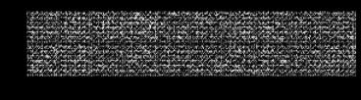
Fashion MNIST
Fashion-MNIST is a dataset of Zalando's (German multinational E-commerce company) article images - consisting of a training set of 60,000 examples and a test set of 10,000 examples. Each image is a 28x28 grayscale image, associated with a label from 10 classes. It shares the same image size and structure of training and testing split.
Notes:
[SKIP]
Fashion MNIST is a dataset of images containing images of clothing from 10 different classes. The dataset provided from the Tensorflow API consists of a training set of 60,000 image/tensor and labels and test set of 10,000 image/tensor and labels. Each image comes as a 28 by 28 tensor of integers, which represents the pixel value between 0 and 255. Each label comes as an integer, which each integer designated to a class.

Slide 6
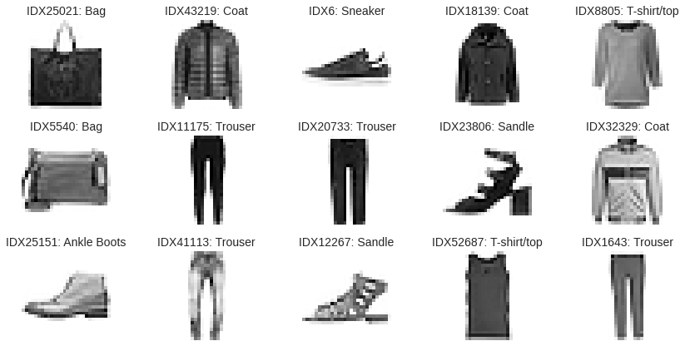
Fashion MNIST
Notes:
[SKIP]
The first step I want to have a preview of the images and labels. I randomly sampled 15 instances from the training set and displayed it as a matplotlib figure. Relatively, we could say for these 15 instances, the images seems to match their designated labels.

Slide 7
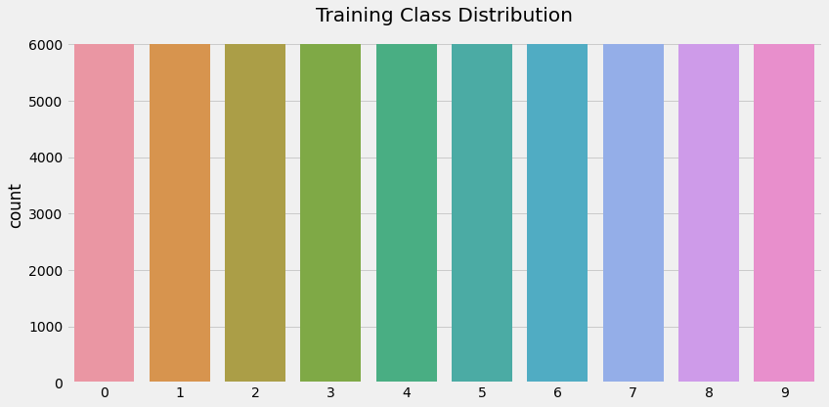
Fashion MNIST
Notes:
[SKIP]
As mentioned earlier, there are 10 classes within the Fashion MNIST dataset. I want to check for the class distribution in the training set if there were any imbalance of classes. Generally, all of the classes have a uniform distribution number of classes.

Slide 8
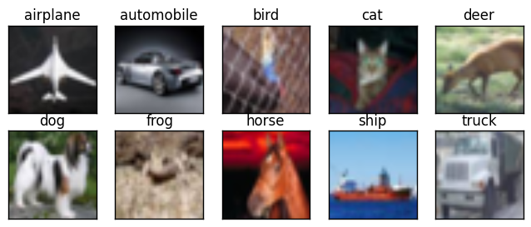
CIFAR-10
CIFAR-10 dataset (Canadian Institute for Advanced Research) is a collection of images that are commonly used to train and benchmark image classification algorithms. It is a subset of 80 million tiny images and consists of 60,000 instances - 32 by 32 coloured images from 10 different classes. There are 50,000 training examples and 10,000 examples.
Notes:
[SKIP]
CIFAR-10 is a dataset of images containing images from 10 different classes. The dataset provided from the Tensorflow API consists of a training set of 50,000 image/tensor and labels and test set of 10,000 image/tensor and labels. Each image comes as a 32 by 32 by 3 tensor of integers, which represents the pixel value between 0 and 255 of 3 different colour channels. Each label comes as an integer, which each integer designated to a class.

Slide 9
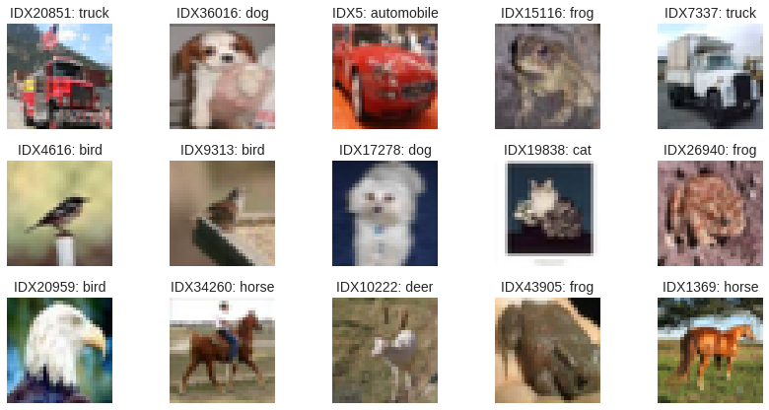
CIFAR-10
Notes:
[SKIP]
The first step I want to have a preview of the images and labels. I randomly sampled 15 instances from the training set and displayed it as a matplotlib figure. Relatively, we could say for these 15 instances, the images seems to match their designated labels.

Slide 10
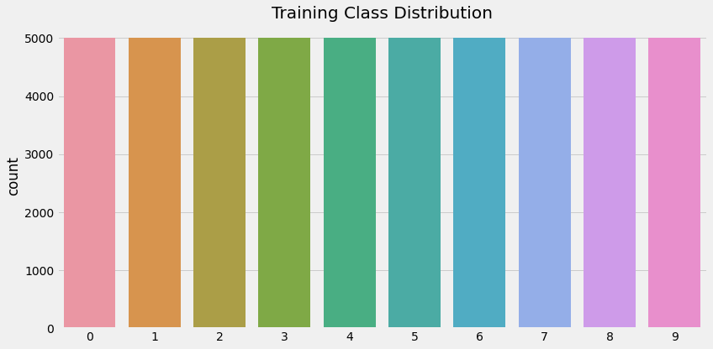
Fashion MNIST
Notes:
[SKIP]
As mentioned earlier, there are 10 classes within the CIFAR-10 dataset. I want to check for the class distribution in the training set if there were any imbalance of classes. Generally, all of the classes have a uniform distribution number of classes. It seems that the dataset is very similar to Fashion MNIST dataset, the only difference would be the colour channels and number of training instances.

Slide 11
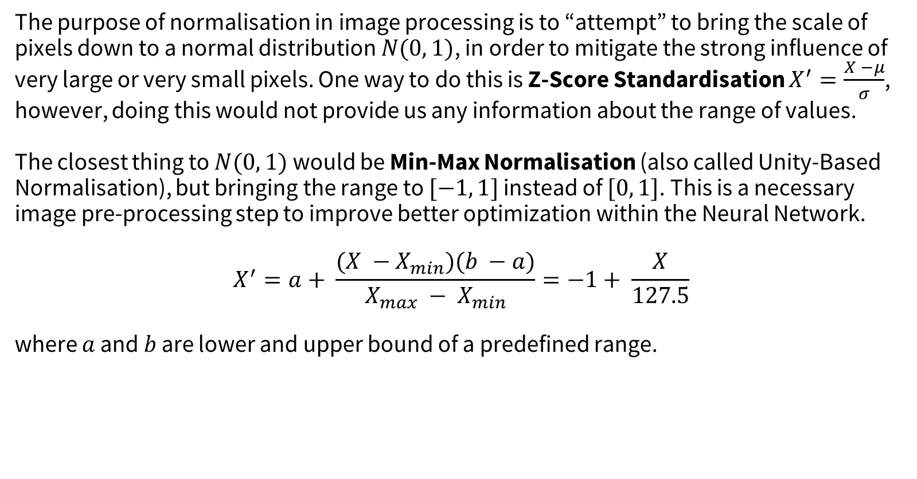
Pixel Normalization / Rescaling
The purpose of normalisation in image processing is to “attempt” to bring the scale of pixels down to a normal distribution $N(0, 1)$, in order to mitigate the strong influence of very large or very small pixels. One way to do this is Z-Score Standardisation $X^{′}=\frac{X −μ}{σ}$, however, doing this would not provide us any information about the range of values.
The closest thing to $N(0, 1)$ would be Min-Max Normalisation (also called Unity-Based Normalisation), but bringing the range to $[−1, 1]$ instead of $[0, 1]$. This is a necessary image pre-processing step to improve better optimization within the Neural Network.
$$X^{′}=a+ \frac{(X −X_{min})(b −a)}{X_{max} − X_{min}}=−1+ \frac{X}{127.5}$$
where $a$ and $b$ are lower and upper bound of a predefined range.
Notes:
<Read off the slides lol>
[BE ABIT FASTER HERE, JUMP STRAIGHT TO MIN MAX NORM]

Slide 12
Reshape and RGB Conversion
For Fashion MNIST, the convolution layer provided in the Keras API is unable to take in 2D tensors (28, 28) as a single instance, as such I converted the images into a 3D tensor (28, 28, 1), with the last dimension representing the dataset only has one colour channel – grayscale.
Furthermore, most modern architectures (e.g. Inception, ResNet, EfficientNet) only supports images with 3 colour channels. To avoid any future implications, I converted the images within Fashion MNIST to RGB colour space in order to avoid any implications (28, 28, 3).

Slide 13
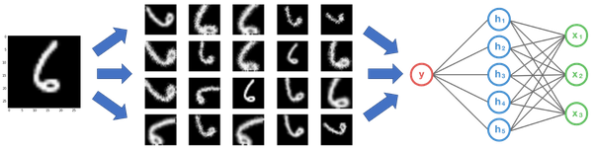
Image Augmentation
Convolutional Neural Network has an ability to greatly generalise/capture the underlying structure of the training images provided through the use of it’s convolution operations. This creates a strong tendency of overfitting within the model.
Using Image Augmentation, we can induce noise into the training data (or also called corruption the training data), in order for the model to have better generalisation. Usually, Image Augmentation is used to mitigate overfitting problems for image classification tasks.

Slide 14
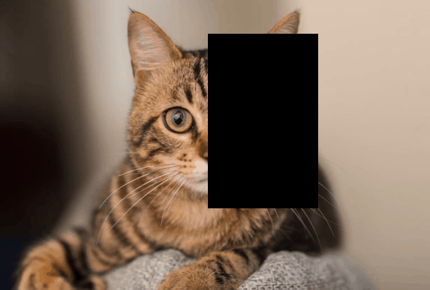
Cutout Augmentation
Cutout Augmentation is a type of image augmentation for Convolutional Neural Networks. It regularize the model by adding random masking into the training images. This prepares the model by learning to take in more features into consideration.
Notes:
I was inspired by other image augmentation methods such as AugMix, CutMix, and MixUp. However, instead of using those methods which has very strong regularisation effect, I decided to go with cutout augmentation.

Slide 15
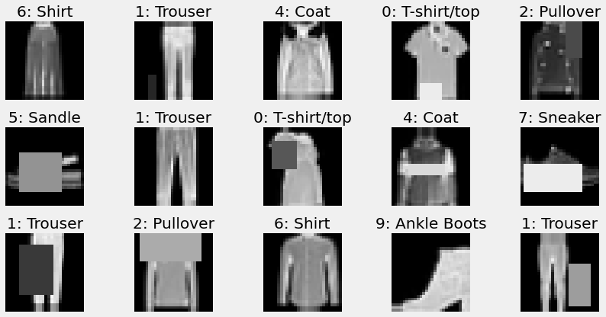
Image Augmentation
Notes:
[SKIP]
These are 15 randomly sampled images with augmentation for Fashion-MNIST. These augmentation were applied – width shift, height shift, random horizontal flipping, random cutout.

Slide 16
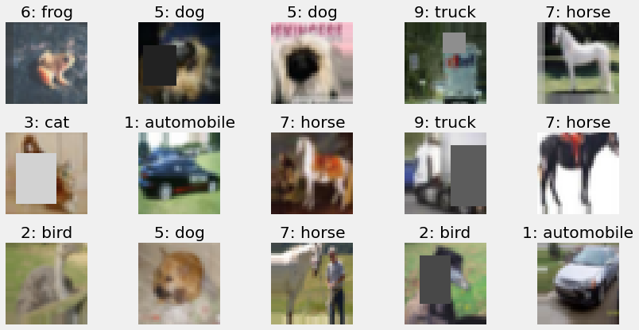
Image Augmentation
Notes:
[SKIP]
These are 15 randomly sampled images from CIFAR-10 with augmentation, the results are not as obvious, but there are some augmentation applied. These augmentation were applied – width shift, height shift, random horizontal flipping, random cutout.

Slide 17
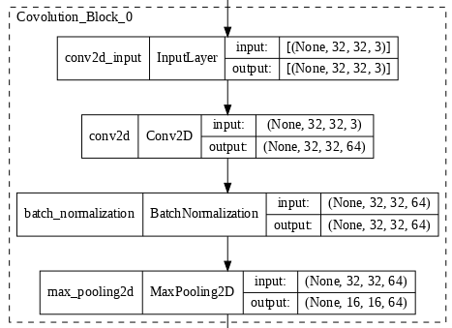
Baseline ConvNet
Notes:
IMPORTANT NOTE: At this point, there is no augmentation added.
I started building my Baseline starting with a Convolution Block. This convolution block is purposed for feature extraction, extracting our key features from the training data through very small receptive filters. This block consist of a Convolutional Layer, Batch Normalization, and Max Pooling. The convolutional layer has a 3 by 3 filter with stride 1, which outputs a feature map based on the number of filters. These feature map is then passed through a ReLU activation function to capture non-linearities. Batch Normalisation is then applied for faster and more stable training in the neural net, through rescaling and recentering. Max Pooling is then applied to downsampled the feature maps produced by the convolution process, in order to reduce the number of trainable parameters within the neural net.

Slide 18
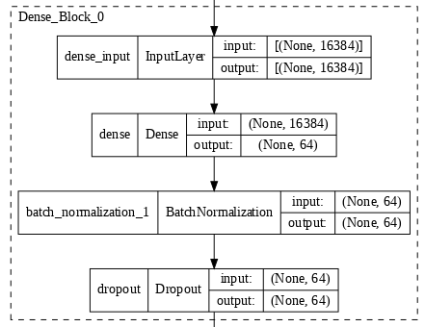
Baseline ConvNet
Notes:
IMPORTANT NOTE: At this point, there is no augmentation added.
Next, I created a Fully Connected Block, consisting of a dense layer, batch normalisation and dropout. This block is purposed for mainly classification of the features maps output from the convolution block.

Slide 19
Baseline ConvNet
Adam Optimizer
A simple optimizer with great performance without requiring much tuning, which reaches convergence faster than SGD.
Sparse Categorical Cross Entropy aka Log Loss
The task is a multi-class image classification problem, thus I used categorical cross entropy to compute the loss of multiple classes. Since the labels are provided as integers, I used Sparse Categorical Cross Entropy as there is no need to encode the labels.
Notes:
IMPORTANT NOTE: At this point, there is no augmentation added.

Slide 20
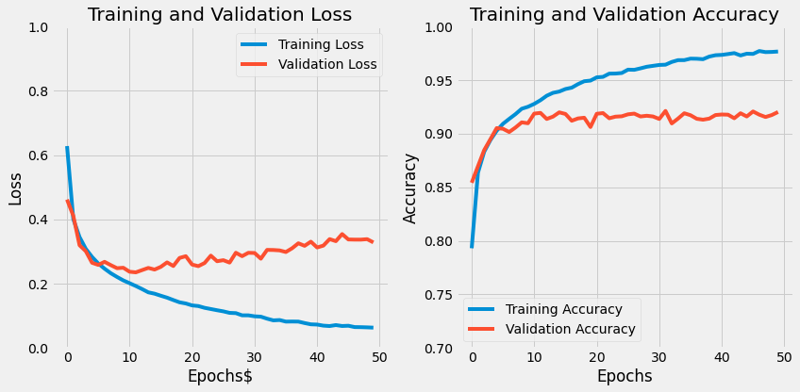
Baseline ConvNet Fashion MNIST
Notes:
IMPORTANT NOTE: At this point, there is no augmentation added.
At the loss function learning curve, we can see that the training and validation loss starts to diverge as the training iterations continue. This creates variance between the training and validation loss, resulting to an overfitting problem.

Slide 21
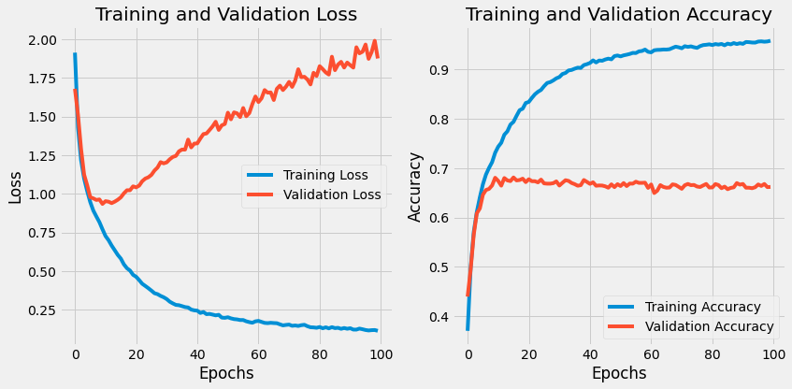
Baseline ConvNet CIFAR-10
Notes:
IMPORTANT NOTE: At this point, there is no augmentation added.
For CIFAR-10, we can see similar indications of overfitting as well. Do note that no augmentation has been added thus far, perhaps adding augmentation could improve this issue of clear overfitting.

Slide 22
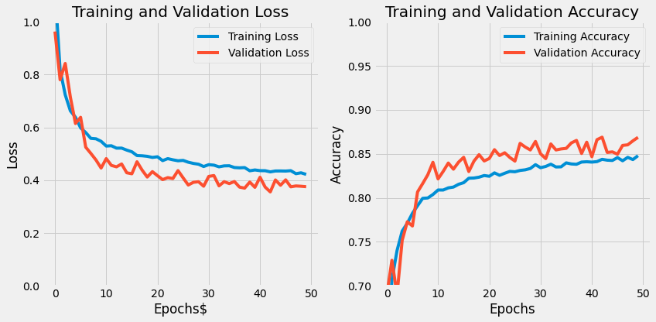
Baseline ConvNet w/ Augmentation - Fashion MNIST
Notes:
By adding augmentation, we can see that the validation accuracy is higher than the training accuracy through the training iterations. This mean that the regularization effect from augmentation is so strong that the model is able to generalise the training data well enough to obtain better accuracy outside of the training data.

Slide 23
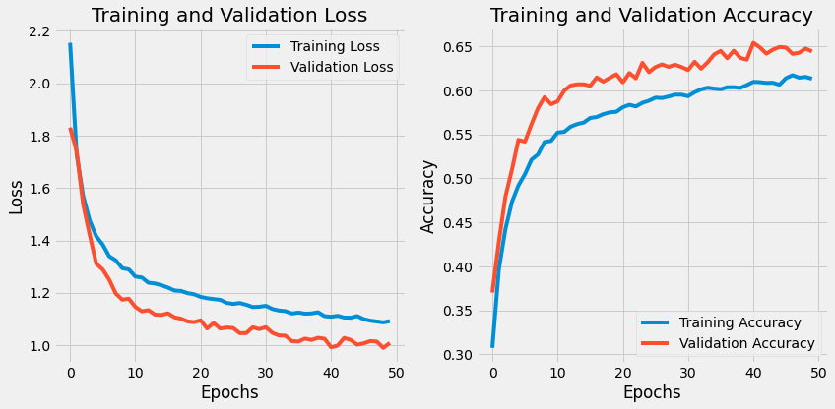
Baseline ConvNet w/ Augmentation - CIFAR-10
Notes:
On CIFAR-10, the same effect can be seen again. We can see our model is hitting about 60% + accuracy for both training and validation.
Moving forward, I want to experiment with different architectures and training strategies in order to greatly improve this result. I do not think Hyperparameter Tuning would be necessary as my network architecture has over millions of parameters and it is not feasible to keep retraining the network for better hyperparameters.

Slide 24
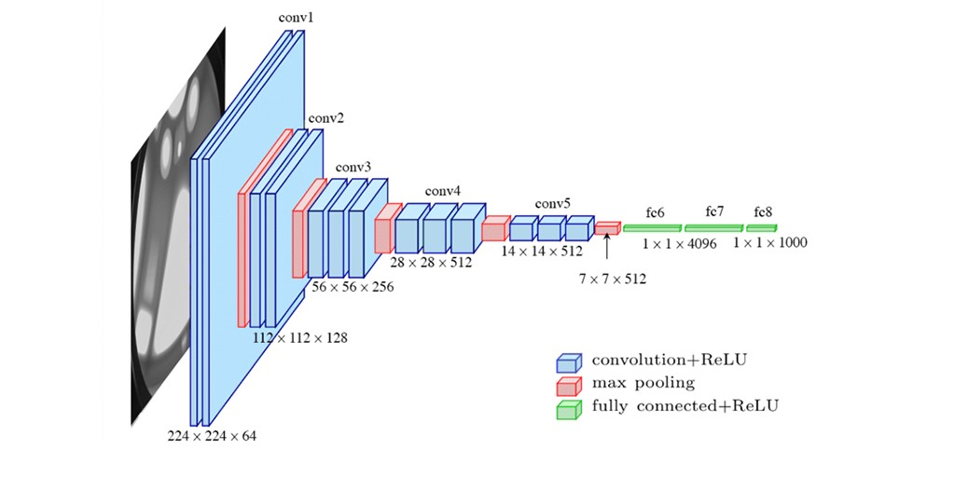
Modified VGG16
Notes:
For my first experimentation, I attempted to use the VGG16 architecture, which came about around 2014. VGG16 architecture is a well known architecture, yet at the same time an architecture with a simple concept, which I think anybody in the class could build it from scratch. A single convolution block consists of 2 or 3 convolutional layer and a pooling layer, then again 2 or 3 convolutional layers and a pooling layer. The network ends with 2 hidden layers and a output layer.
There are a few issues I would like to address with this architecture. Firstly, there are too many parameters in the architecture, about 130 million+ parameters within the model. Secondly, there isn’t any dropout or layers for regularization, making the model more prone to overfitting. With these issues, I will make some modification to the original architecture to fit out tasks – Fashion MNIST and CIFAR-10.

Slide 25
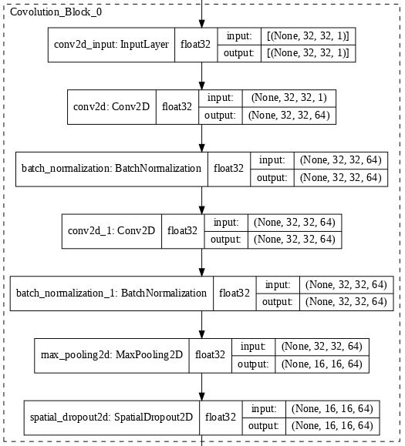
Modified VGG16 Block
Notes:
The idea of each convolution block is that it stacks multiple convolutional layers and a single pooling layer for each block. Here, I added batch normalization after each convolution layer and I add 2D dropout after each pooling layer. This is done to improve performance and induce some form of regularization within the CNN.

Slide 26
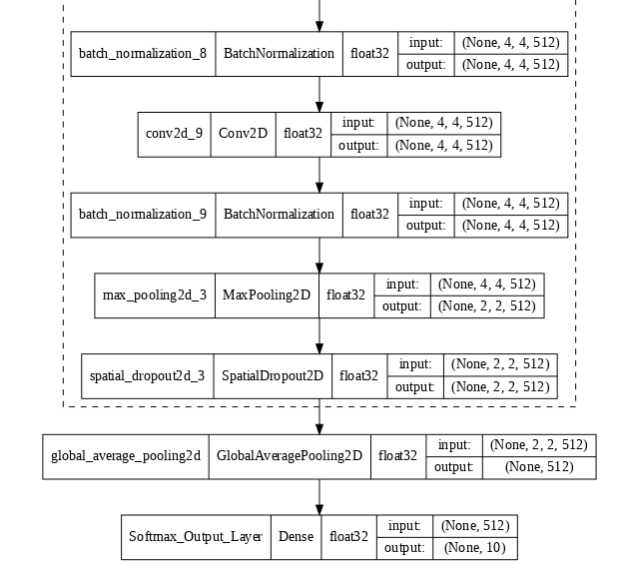
Global Average Pooling
Notes:
In the original VGG16 architecture, the network ends with 2 hidden layers and a output layer. The hidden layers are usually the layers that brings about the most number of parameters in a typical CNN architecture, which then brought issues of increasing number of training time, model complexity, longer backpropagation steps.
Instead of ending with hidden layers, I was inspired by modern architectures by ending the network with Global Average Pooling. Global Average Pooling directly output the spatial average of each feature maps. This results a vector that brings more information related to the original training image, rather than passing through hidden layers which is just a black box. With global average pooling, I can reduce the total number of parameters and layers, which reduces the number of steps in backpropagation.

Slide 27
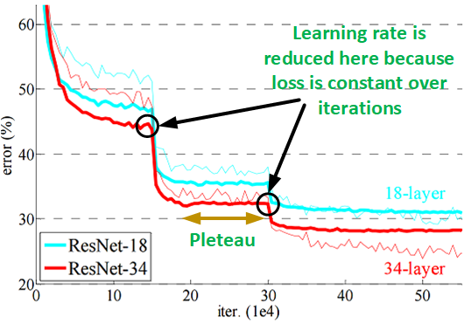
Reduce Learning Rate on Plateau
The intuition is to start with a large learning rate to quickly approach a local minima, and reduce it by a certain factor when the validation loss reaches a plateau. This method of having a dynamic learning rate can helps to get out of a local minima.

Slide 28
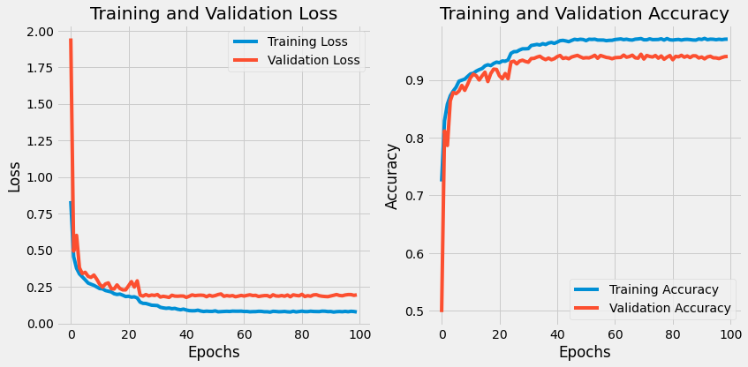
Modified VGG16 Fashion MNIST
Notes:
[FROM LEARNING CURVE] 97.06 94.07
[FROM TRAIN-TEST EVALUATION] 98.02 94.71
We can see some overfitting within the model, however the validation accuracy has increased greatly from the baseline model, reaching about 94%.

Slide 29
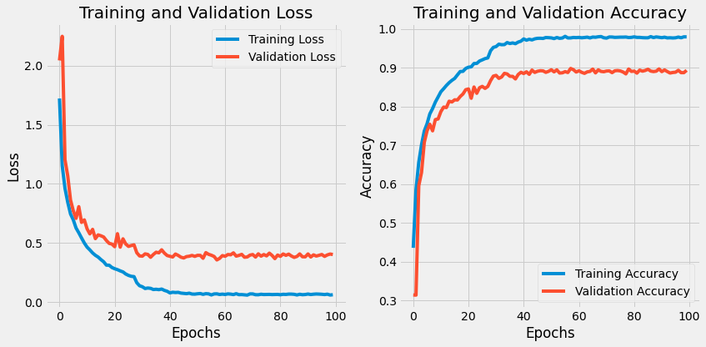
Modified VGG16 CIFAR-10
Notes:
[FROM LEARNING CURVE] Training Accuracy: 97.94%; Validation Accuracy 89.32%
[FROM TRAIN-TEST EVALUATION] Training Accuracy: 99.02%; Test Accuracy 90.80%
The same results can also be seen for CIFAR-10. The validation accuracy has increased greatly to 89% from the baseline validation accuracy. Next, I want to experiment with another CNN architecture – ResNet.

Slide 30
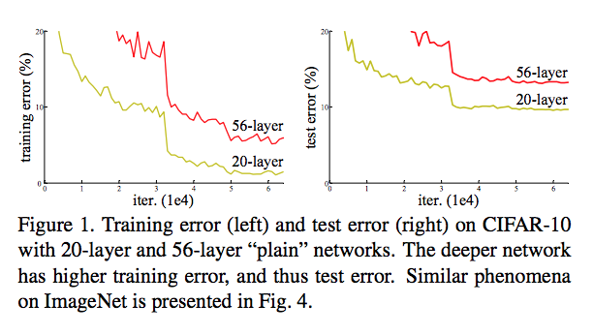
Issues with VGG16
There is an issue with deeper neural networks like VGG16. As the Neural Network gets deeper (stacking more layers), the architecture would reach a point during training when the gradients would be infinitely large or become zero due to chain rule computation in backpropagation. These issues are commonly referred as Exploding Gradient or Vanishing Gradient problem.
Notes:
There is an issue with deeper neural networks like VGG16. As the Neural Network gets deeper (stacking more layers), the architecture would reach a point during training when the gradients would be infinitely large or become zero due to chain rule computation in backpropagation. These issues are commonly referred as Exploding Gradient or Vanishing Gradient problem. These were the problems faced using VGG by the original authors of ResNet, especially Vanishing Gradient.
Thus, increase the number of layers in a NN does not necessarily correspond to achieve better accuracy.

Slide 31
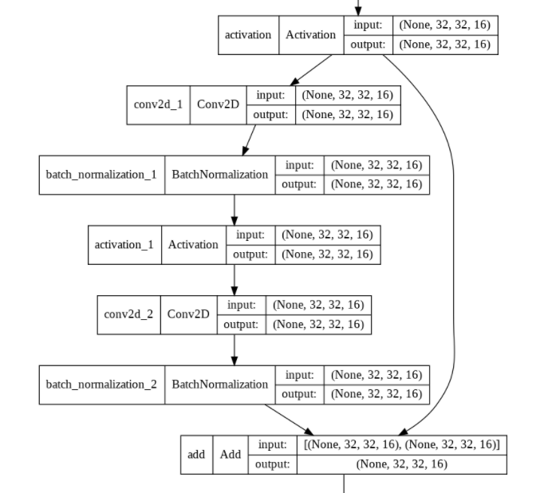
Residual Module
Notes:
With these issues in mind, let’s explore the residual module. The original author of ResNet suggested the concepts of shortcut connection (or also called skip connections). The intuition of shortcut connection is to map the previous output of the entire module to the output of the current module, which uses Identity Mapping. The ensures that during training even if there is an encounter to vanishing gradient, the output of the Residual Module will not be zero due to shortcut connections.

Slide 32
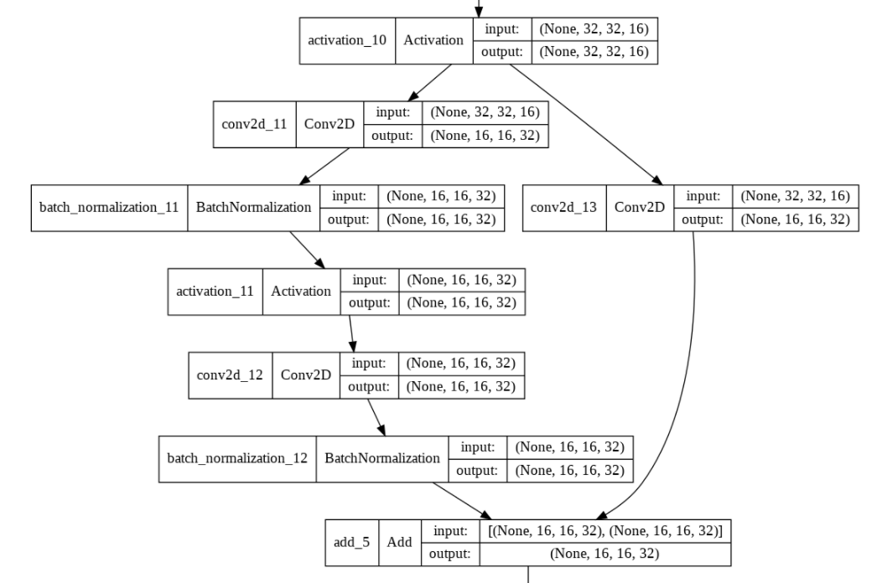
Residual Module
Notes:
However, there might be one question – “What if the input shape does not match with the output shape due to down sampling operations?” ResNet solves this issue by adding a convolution layer with 1 by 1 filter in it’s shortcut connection to match the input and output size. In other variations of ResNet, batch normalization and max pooling are sometimes added into the shortcut connection to improve performance of the shortcut connection.

Slide 33
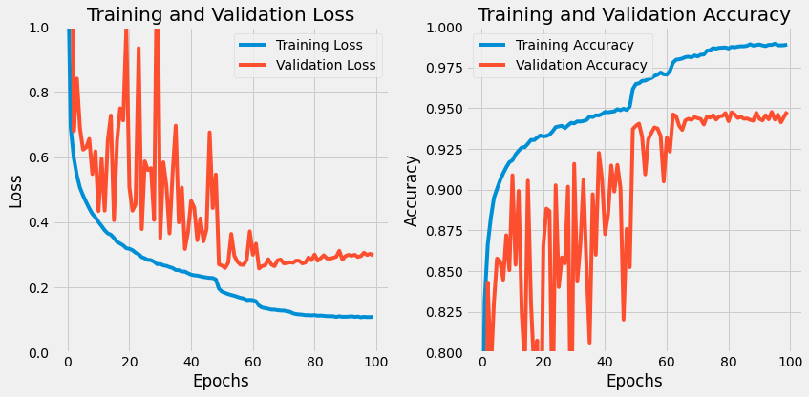
ResNet Fashion MNIST
Notes:
[Learning Curve] 98.90 94.78
[From Train-Test Evaluation] 98.19 93.92
Learning has been very volatile, as seen by the validation loss, likely to be caused by the shortcut connection Training and Validation loss starts to diverge, a clear indication of overfitting or starting to overfit.

Slide 34
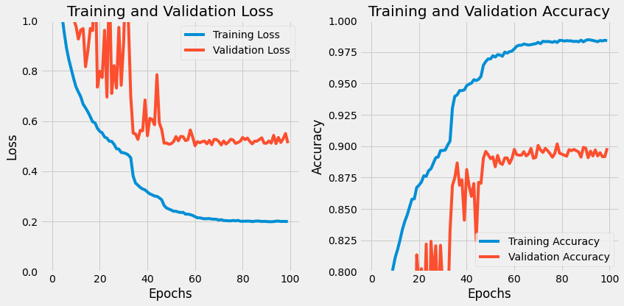
ResNet CIFAR-10
Notes:
[Learning Curve] 98.39 89.84
[From Train-Test Evaluation] 97.34 89.00
Same pattern occurs for CIFAR-10. Overfitting and volatile learning. Next step, I want to pass in the entire training data for training, and put the testing set as validation; with some hopes in improvement of testing accuracy.

Slide 35
Fashion MNIST
Fashion MNIST Architecture | Training Accuracy (%) [1] | Validation Accuracy (%) | Train Accuracy (%) [2] | Test Accuracy (%)
Baseline Convolutional Neural Network | 97.66 | 92.02 | 98.66 | 91.38
Baseline CNN with Image Augmentation | 84.78 | 86.87 | 89.50 | 88.09
Modified VGG16 | 97.06 | 94.07 | 98.02 | 94.71
ResNet | 98.90 | 94.78 | 98.19 | 93.92
Modified VGG16 w/ Full Train Data | 96.59 | 94.69 | 98.00 | 94.69
ResNet w/ Full Train Data | 98.63 | 94.31 | 98.37 | 94.31
Notes:
[1]: Training Accuracy from Training Iterations (Epochs)
[2]: Full training set being pass through evaluation
Training Accuracy and Validation Accuracy are fitted with Augmentation when Augmentation is applied
We could see here that the Modified VGG16 has achieved the first personal objective of achieving high test accuracy, which also came second when passed in through the entire training data.

Slide 36
CIFAR-10
CIFAR-10 Architecture | Training Accuracy (%) [1] | Validation Accuracy (%) | Train Accuracy (%) [2] | Test Accuracy (%)
Baseline Convolutional Neural Network | 95.86 | 66.22 | 96.59 | 65.62
Baseline CNN with Image Augmentation | 61.34 | 64.44 | 69.71 | 67.61
Modified VGG16 | 97.94 | 89.32 | 99.02 | 90.80
ResNet | 98.39 | 89.84 | 97.34 | 89.00
Modified VGG16 w/ Full Train Data | 96.44 | 89.86 | 99.35 | 89.86
ResNet w/ Full Train Data | 99.40 | 90.48 | 99.13 | 90.48
Notes:
[1]: Training Accuracy from Training Iterations (Epochs)
[2]: Full training set being pass through evaluation
Training Accuracy and Validation Accuracy are fitted with Augmentation when Augmentation is applied
Modified VGG16 has achieved the highest test acc, however the results from ResNet provided more consistency in validation accuracy together with test accuracy.

Slide 37
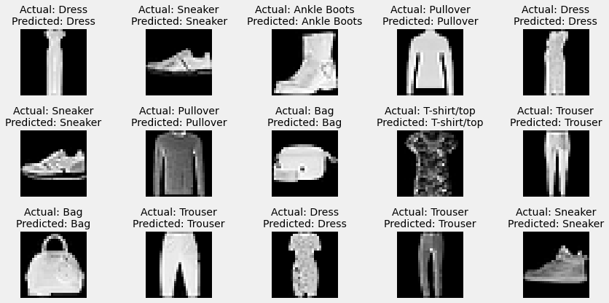
Fashion MNIST
Notes:
<skip this part if there is no time>
After randomly sampling 15 images, we could see that the Modified VGG has accurately predicted all 15 images.

Slide 38
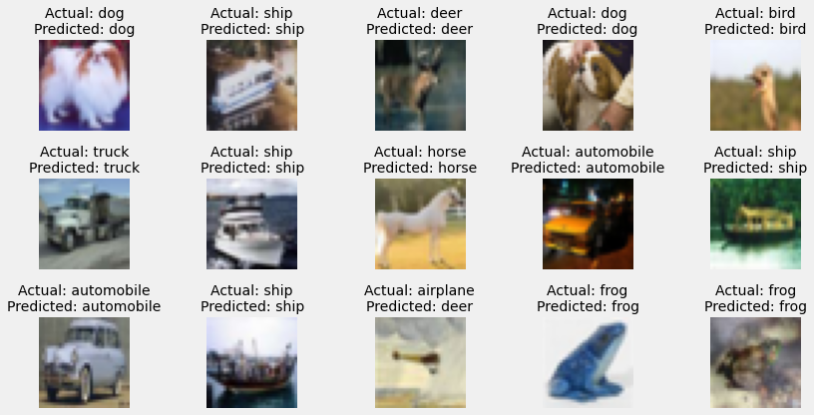
CIFAR-10
Notes:
<skip this part if there is no time>
After randomly sampling 15 images from CIFAR-10, we can see that ResNet is able to predict 14 out of 15 accurately.

Slide 39
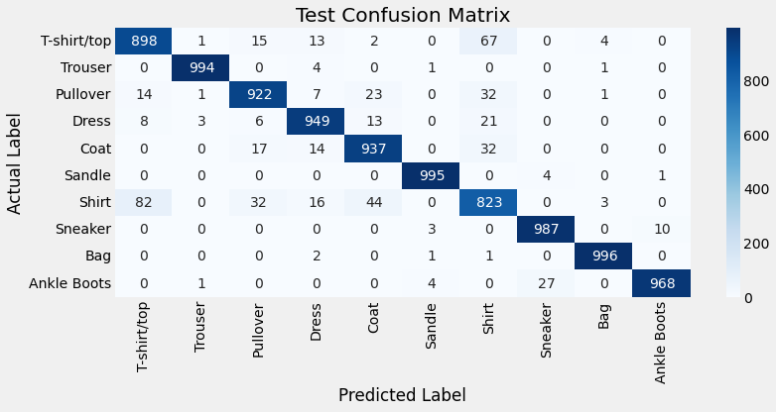
Fashion MNIST
Notes:
Creating a confusion matrix here, we can see a trend where upper body clothing tend to be misclassified such as t-shirt, coat, and shirt.

Slide 40
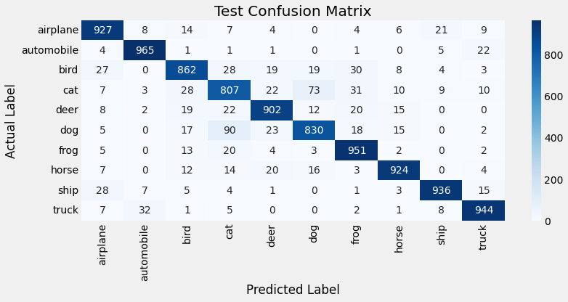
CIFAR-10
Notes:
For CIFAR-10, we could see Cat and Dogs tend to be misclassified for each other, which is justifiable for smaller animals to be misclassified.

Slide 41
Conclusion/Further Improvements
Both personal objectives of mine has been successfully fulfilled.
Classes of similar features (e.g. Fashion MNIST: upper body clothing, CIFAR-10: smaller animals) has a tendency to be misclassified in CNN.
For further improvements, I could have done a few more things.
Try modern augmentation techniques such as AugMix, CutMix
Try the latest model architectures such as EfficientNet as VGG16 and ResNet came about 2014 – 2015.
Moving forward in life, Image Classification is just a small part of Computer Vision, I would like to try out more projects such as Object Localization (R-CNN), OCR, and Semantic Segmentation that might have more meaningful experiences.

